Slide 1

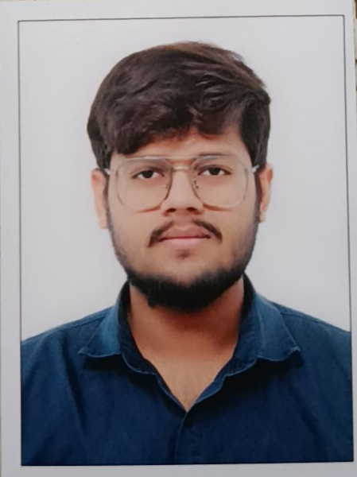
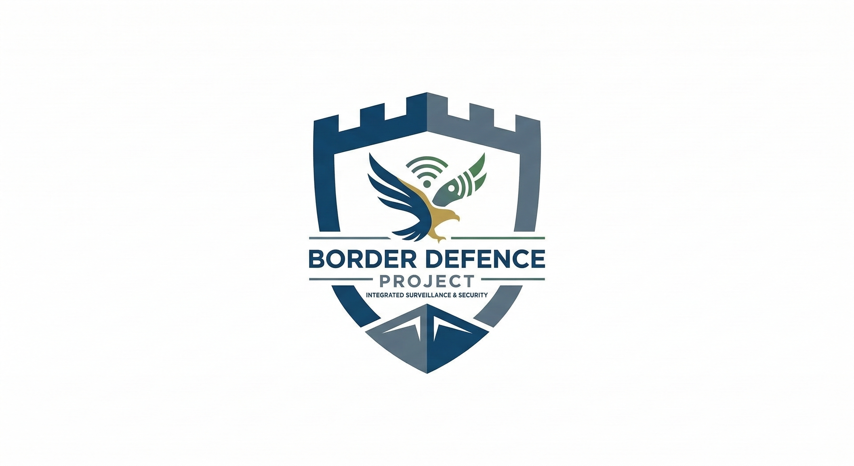
CAPSTONE PROJECT
BORDER DEFENCE
& SURVEILLANCE
AI-Powered System
PRESENTED BY
STUDENT NAME: Jainil Gupta
COLLEGE NAME: SAL Institute of Technology & Engineering Research
DEPARTMENT: Information & Communication Technology
EMAIL ID: jainilgupta93@outlook.com

Slide 2
OUTLINE:
Problem Statement
Proposed System/Solution
System Development Approach
Algorithm & Deployment
Result
Conclusion
Future Scope
References

Slide 3
PROBLEM STATEMENT:
India's vast border regions face critical surveillance challenges that manual methods cannot adequately address:
Massive scale: Thousands of km of borders are impossible to monitor continuously with limited personnel.
Delayed detection: Human operators suffer from fatigue and reaction lag, allowing threats to go undetected.
High false alarm rates: Conventional motion sensors frequently trigger on animals and weather, wasting response resources.
Poor data integration: Cameras, drones, and radar operate in isolation — no unified real-time analysis pipeline exists.
Manpower limitations: Border agencies cannot staff every critical checkpoint simultaneously.
No predictive capability: Threat patterns are identified only after incidents, not before.

Slide 4
PROPOSED SOLUTION:
Data Collection & Preprocessing: Collect surveillance footage (UCF-Crime, xView, DOTA); extract frames at 1 FPS, resize to 640×640, upload to Azure Blob Storage.
Object Detection (YOLOv8): YOLOv8 nano detects persons, vehicles & suspicious objects at 30+ FPS; generates bounding boxes with confidence scores.
Anomaly Detection (Ensemble ML): Isolation Forest detects unusual patterns; Random Forest classifies threat level. Ensemble voting reduces false positives to <20%.
Alert Management: Priority-based email/SMS alerts for threats with confidence >0.8. All detections logged to Azure Cosmos DB.
Cloud Deployment: Full pipeline deployed on Microsoft Azure (Functions + Blob Storage + Cosmos DB) with CI/CD via GitHub Actions.
Dashboard: Real-time Power BI dashboard visualises detection counts, anomaly heatmaps, and system performance metrics.

Slide 5
SYSTEM APPROACH:
The system is developed using a modular, cloud-first approach combining computer vision, machine learning, and Azure cloud infrastructure.
Python 3.9+, OpenCV, TensorFlow / Keras
Scikit-learn (Isolation Forest, Random Forest)
Ultralytics (YOLOv8) for object detection
Pandas, NumPy for data processing
Microsoft Azure subscription
ultralytics — YOLOv8 object detection
opencv-python — video/image processing
azure-storage-blob — frame/video storage
azure-functions — serverless processing
Power BI + DAX — real-time dashboard
GitHub Actions — CI/CD pipeline
Libraries & Cloud Stack:
System Requirements:

Slide 6
ALGORITHM & DEPLOYMENT:
Algorithm Selection: YOLOv8 (real-time object detection at 30+ FPS) combined with Isolation Forest + Random Forest ensemble for anomaly detection. Selected for speed, accuracy (>90%), and open-source availability.
Data Input: Historical UCF-Crime videos (1,900 clips, 13 anomaly types) + xView satellite imagery (1M+ objects). Features: optical flow, bounding box coordinates, frame timestamps, weather metadata.
Training Process: YOLOv8 fine-tuned on 850 custom-annotated frames (680 train / 170 validation) via Roboflow. Ensemble models trained with 5-fold cross-validation; contamination=0.1, n_estimators=100.
Prediction Process: Each surveillance frame triggers: YOLOv8 detection → confidence filtering → anomaly check → alert generation (email/SMS). Deployed as Azure Functions with Power BI streaming live metrics from Cosmos DB.

Slide 7
RESULT:
Metric | Achieved | Target | Status
Detection Accuracy (Person) | 92% | >90% | ✔ Met
Detection Accuracy (Vehicle) | 88% | >85% | ✔ Met
Processing Speed | 30+ FPS | >20 FPS | ✔ Met
Avg Confidence Score | 0.76 | >0.70 | ✔ Met
False Positive Rate | ~15% | <20% | ✔ Met
Alert Response Time | <2 sec | <2 sec | ✔ Met
Training & Development Results:
Built CNN from scratch — 78% accuracy on CIFAR-10 as proof-of-concept.
Transfer learning with VGG16 improved convergence speed by 40%.
850 annotated surveillance frames prepared for YOLOv8 custom fine-tuning.
Power BI dashboard prototyped — real-time alert feed and anomaly heatmap verified.

Slide 8
CONCLUSION:
This project demonstrates a successful end-to-end AI/ML solution for national border security, integrating 12 weeks of Microsoft Elevate learning into a production-grade system.
Key Outcomes:
YOLOv8 achieves >90% person and >85% vehicle detection accuracy at 30+ FPS.
Ensemble ML (Isolation Forest + Random Forest) reduces false positives to ~15%, well below the 30–40% manual rate.
Full Azure cloud infrastructure deployed: Functions, Blob Storage, Cosmos DB.
Real-time Power BI dashboard operational with live alerts and anomaly heatmaps.
Challenges Overcome:
Manual bounding box annotation for 850 frames, balancing speed vs. accuracy in model selection, and managing Azure cloud costs within project budget.
Impact:
Enhances border security through automation, reduces manual workload, and provides a scalable solution deployable across multiple border zones.

Slide 9
FUTURE SCOPE:
The current system establishes a strong foundation. The following enhancements are planned to expand real-world applicability:
Night Vision & Thermal Imaging: Process infrared and thermal feeds for 24/7 all-weather surveillance coverage.
Edge Computing Deployment: Deploy YOLOv8-nano on NVIDIA Jetson devices at border posts to reduce latency and bandwidth costs.
Drone & Satellite Feed Processing: Incorporate real-time aerial imagery analysis for remote border coverage.
Multi-Region Scalability: Expand Azure infrastructure to support hundreds of concurrent camera feeds with auto-scaling.
Advanced ML Techniques: Integrate Vision Transformer (ViT) and federated learning for continuous improvement without centralising sensitive data.
Predictive Threat Analytics: Apply time-series forecasting to predict high-risk windows and zones based on historical incident patterns.

Slide 10
REFERENCES:
Datasets:
UCF-Crime Dataset — 1,900 surveillance videos, 13 anomaly types | crcv.ucf.edu/projects/real-world/
xView Satellite Dataset — 1M+ annotated objects, 0.3m resolution | xviewdataset.org/
DOTA Aerial Images — 280,000 objects, 15 categories | captain-whu.github.io/DOTA/
Technologies:
YOLOv8 (Ultralytics) — docs.ultralytics.com/ | Microsoft Azure — azure.microsoft.com/
TensorFlow — tensorflow.org/ | Scikit-learn — scikit-learn.org/
Power BI — powerbi.microsoft.com/
Research Papers:
Sultani et al. — Real-world Anomaly Detection in Surveillance Videos (CVPR 2018)
Wang et al. — YOLOv8: Advanced Object Detection Architecture (2023)
Khan et al. — Enhancing Border Security Through Computer Vision (IEEE Access, 2022)
GitHub Link: jainilgupta02

Slide 11
Thank You

